Slide 1
Induction of Voting Assemblies
Presenter: 許惟哲、周崑水

Slide 2
Outline
Background of Induction of Voting Assemblies
Booststrap Aggregation
Schapire’s Boosting
Schapire’s Boosting Limitations
Adaboost: Practical Version of Boosting
Variations on the Boosting Themes
Base Classifers redescribe the examples
Cost Saving Benefit
Adaptive Boosting

Slide 3
Background
A group of classifiers is created in a way that makes each of them somewhat different.
Classification algorithm
Training set selection
When they vote about the recommended class, their “collective wisdom” often compensates for each individual’s imperfections.
Note: We will limit ourselves to the field of two-class domains where each example is either positive or negative.

Slide 4
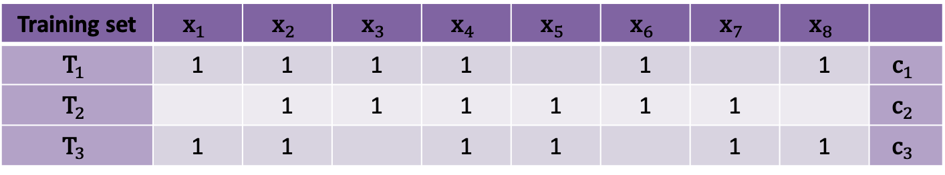
Bagging
The name is an acronym of booststrap aggregation.
Training set selection: Using random sampling with replacement
Training set | $${\text{x}}_{1}$$ | $${\text{x}}_{2}$$ | $${\text{x}}_{3}$$ | $${\text{x}}_{4}$$ | $${\text{x}}_{5}$$ | $${\text{x}}_{6}$$ | $${\text{x}}_{7}$$ | $${\text{x}}_{8}$$
$${\text{T}}_{1}$$ | 1 | 1 | 1 | 1 |  | 1 |  | 1 | $${\text{c}}_{1}$$
$${\text{T}}_{2}$$ |  | 1 | 1 | 1 | 1 | 1 | 1 |  | $${\text{c}}_{2}$$
$${\text{T}}_{3}$$ | 1 | 1 |  | 1 | 1 |  | 1 | 1 | $${\text{c}}_{3}$$

Slide 5
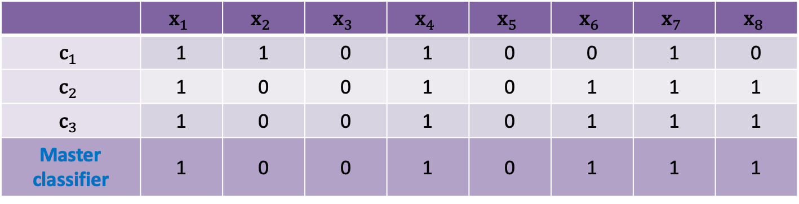
Bagging: Master classifier
A “master classifier” decides which of the two classes received more votes.
1: positive, 2: negative
 | $${\text{x}}_{1}$$ | $${\text{x}}_{2}$$ | $${\text{x}}_{3}$$ | $${\text{x}}_{4}$$ | $${\text{x}}_{5}$$ | $${\text{x}}_{6}$$ | $${\text{x}}_{7}$$ | $${\text{x}}_{8}$$
$${\text{c}}_{1}$$ | 1 | 1 | 0 | 1 | 0 | 0 | 1 | 0
$${\text{c}}_{2}$$ | 1 | 0 | 0 | 1 | 0 | 1 | 1 | 1
$${\text{c}}_{3}$$ | 1 | 0 | 0 | 1 | 0 | 1 | 1 | 1
Master classifier | 1 | 0 | 0 | 1 | 0 | 1 | 1 | 1

Slide 6
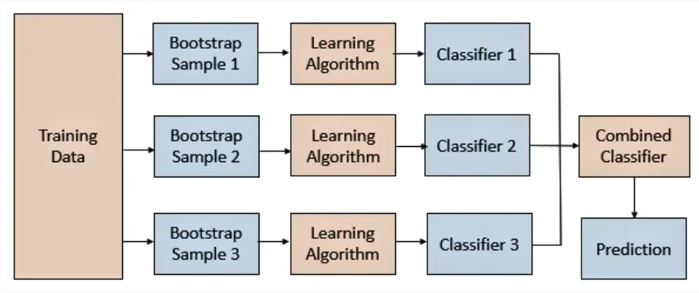
Bagging Flow
Training subset
Master classifier

Slide 7
Schapire’s Boosting
Shortcoming of bagging approach: the voting classifiers have all been induced independently of each other from randomly selected data.
Rely on a mechanism that makes the classifiers complement each other.
Each of the training sets, Ti, is of the same size, m.

Slide 8
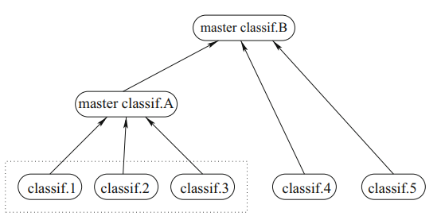
Recursive Application of Schapire’s Boosting
Recursive Implementation:

Slide 9
Schapire’s Boosting Algorithm
Input: the training set, T, and the user’s choice of the induction technique.
Create a random training subset, T1, and induce from it classifier C1
Create a training subset T2 in a manner that makes sure that C1 scores 50% on it. Induce from T2 classifier C2.
Create T3 such that C1 and C2 disagree on each of the examples it contains. Induce from T3 classifier C3.
For classification, use plain majority voting.

Slide 10
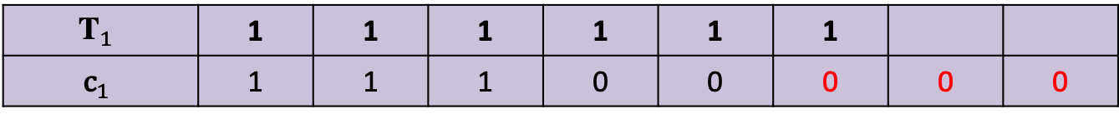
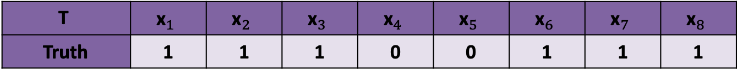
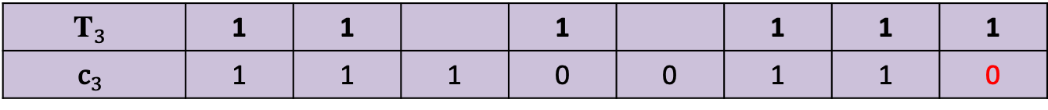
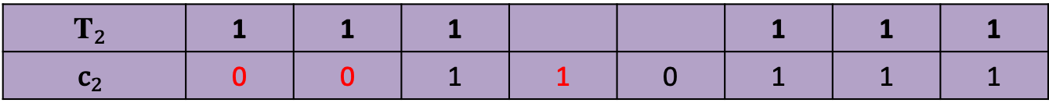
Schapire’s Boosting: Training set selection
$$\text{T}$$ | $${\text{x}}_{1}$$ | $${\text{x}}_{2}$$ | $${\text{x}}_{3}$$ | $${\text{x}}_{4}$$ | $${\text{x}}_{5}$$ | $${\text{x}}_{6}$$ | $${\text{x}}_{7}$$ | $${\text{x}}_{8}$$
Truth | 1 | 1 | 1 | 0 | 0 | 1 | 1 | 1
$${\text{T}}_{1}$$ | 1 | 1 | 1 | 1 | 1 | 1
$${\text{c}}_{1}$$ | 1 | 1 | 1 | 0 | 0 | 0 | 0 | 0
$${\text{T}}_{2}$$ | 1 | 1 | 1 |  |  | 1 | 1 | 1
$${\text{c}}_{2}$$ | 0 | 0 | 1 | 1 | 0 | 1 | 1 | 1
$${\text{T}}_{3}$$ | 1 | 1 |  | 1 |  | 1 | 1 | 1
$${\text{c}}_{3}$$ | 1 | 1 | 1 | 0 | 0 | 1 | 1 | 0
Master classifier A | 1 | 1 | 1 | 0 | 0 | 1 | 1 | 0
Notes:
相依性、互補

Slide 11
Schapire’s Boosting Limitations
How to find the right examples for each of the subsequent training subsets?
If the entire training set that we have 100 examples, and the first classifier’s error rate is 10%, then we have only 10 misclassified examples, to which 10 correctly classified examples are added to create T2; this means that the size of T2 cannot exceed 20.

Slide 12
Adaboost: Practical Version of Boosting
The mechanism is implemented in a way that makes sure that examples that were repeatedly misclassified by the previous classifiers will get a higher chance of being included in the training subset.
Probabilistic selection of training examples
Weighted majority voting scheme is used.

Slide 13
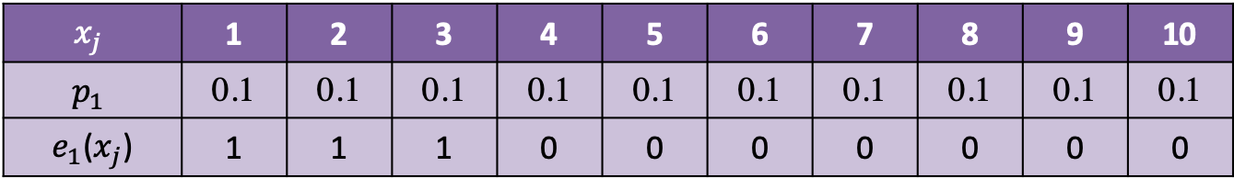
Adaboost Procedure (1)
At the beginning, when the first training set, T1, is being created, each example has the same chance of being selected.
If T consists of m examples, then the probability of each example is p = 1/m.
$$x_{j}$$ | 1 | 2 | 3 | 4 | 5 | 6 | 7 | 8 | 9 | 10
$$p_{1}$$ | 0.1 | 0.1 | 0.1 | 0.1 | 0.1 | 0.1 | 0.1 | 0.1 | 0.1 | 0.1
$e_{1}$($x_{j}$) | 1 | 1 | 1 | 0 | 0 | 0 | 0 | 0 | 0 | 0

Slide 14
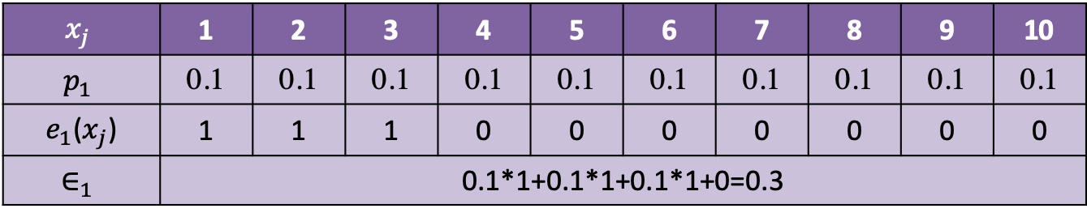
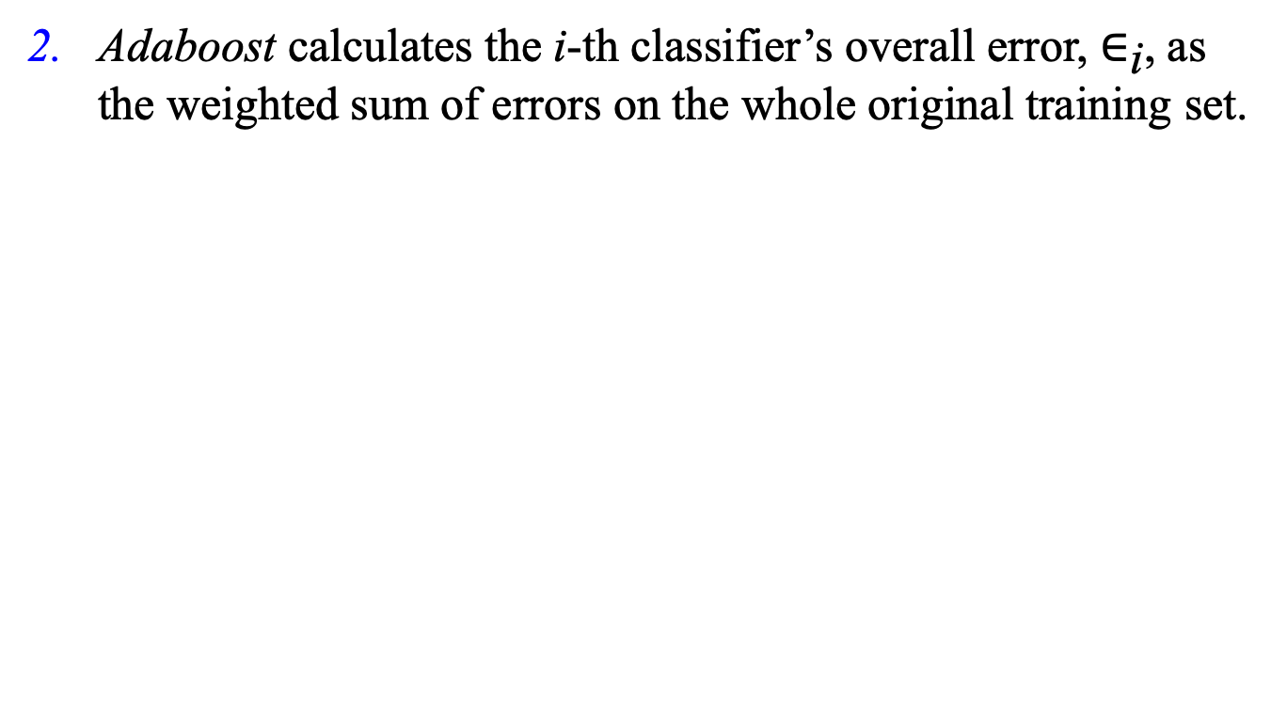
Adaboost Procedure (2)
Adaboost calculates the i-th classifier’s overall error, $∈_{\text{i}}$, as the weighted sum of errors on the whole original training set.
$$x_{j}$$ | 1 | 2 | 3 | 4 | 5 | 6 | 7 | 8 | 9 | 10
$$p_{1}$$ | 0.1 | 0.1 | 0.1 | 0.1 | 0.1 | 0.1 | 0.1 | 0.1 | 0.1 | 0.1
$e_{1}$($x_{j}$) | 1 | 1 | 1 | 0 | 0 | 0 | 0 | 0 | 0 | 0
$${\text{∈}}_{1}$$ | 0.1*1+0.1*1+0.1*1+0=0.3

Slide 15
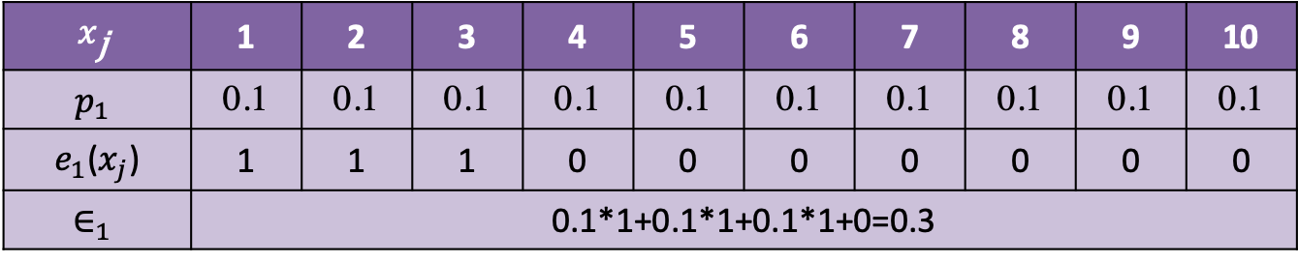
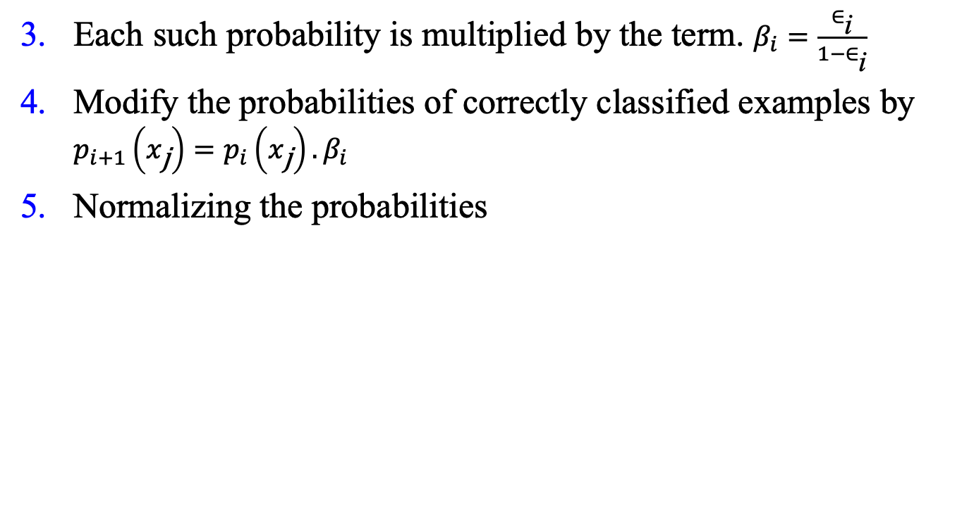
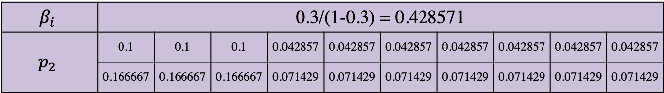
Adaboost Procedure (3)
Each such probability is multiplied by the term. $β_{i}=\frac{∈_{\text{i}}}{1−∈_{\text{i}}}$
Modify the probabilities of correctly classified examples by $p_{i+1}\left(x_{\text{j}}\right)=p_{i}\left(x_{\text{j}}\right).β_{i}$
Normalizing the probabilities
$$x_{\text{j}}$$ | 1 | 2 | 3 | 4 | 5 | 6 | 7 | 8 | 9 | 10
$$p_{1}$$ | 0.1 | 0.1 | 0.1 | 0.1 | 0.1 | 0.1 | 0.1 | 0.1 | 0.1 | 0.1
$e_{1}$($x_{j}$) | 1 | 1 | 1 | 0 | 0 | 0 | 0 | 0 | 0 | 0
$${\text{∈}}_{1}$$ | 0.1*1+0.1*1+0.1*1+0=0.3
$$β_{i}$$ | 0.3/(1-0.3) = 0.428571
$$p_{2}$$ | 0.1 | 0.1 | 0.1 | 0.042857 | 0.042857 | 0.042857 | 0.042857 | 0.042857 | 0.042857 | 0.042857
 | 0.166667 | 0.166667 | 0.166667 | 0.071429 | 0.071429 | 0.071429 | 0.071429 | 0.071429 | 0.071429 | 0.071429

Slide 16
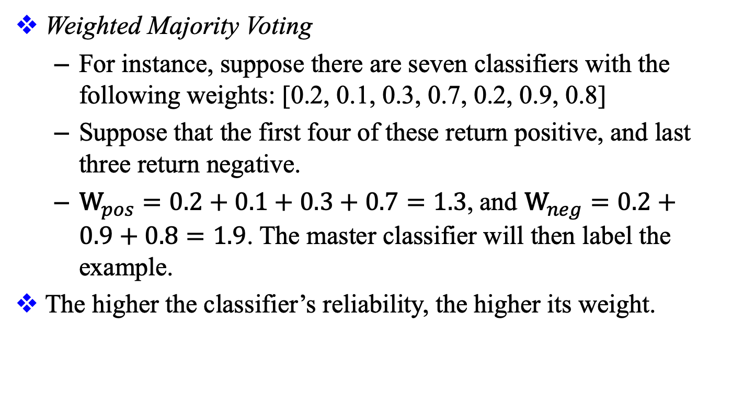
Adaboost Procedure (4)
Weighted Majority Voting
For instance, suppose there are seven classifiers with the following weights: [0.2, 0.1, 0.3, 0.7, 0.2, 0.9, 0.8]
Suppose that the first four of these return positive, and last three return negative.
${\text{W}}_{pos}=0.2+0.1+0.3+0.7=1.3$, and ${\text{W}}_{neg}=0.2+0.9+0.8=1.9$. The master classifier will then label the example.
The higher the classifier’s reliability, the higher its weight.

Slide 17
Summary
 | Bagging | Schapire’s Boosting | Adaboost
Classifier | Independent | Dependent | Dependent
Sampling | Random | Complement | Probability
Voting | Plain | Plain | Weighted

Slide 18
Variations on the Boosting Themes
Complement each other makes perfect ( 彼此互補、相得益彰 ）
Randomizing the subset of examples or attributes set ( subset of rows or colums )
Non-homogeneous Boosting
Each classifier is induced from the same data, but with a different machine-learning technique
Staking
Two layers - Hybride the base level & the master level
linear classifier - such as perceptron as the master classifier
Any paradigm can also be used for master clasifier such as Bayesian, nearest neighbor based etc,

Slide 19
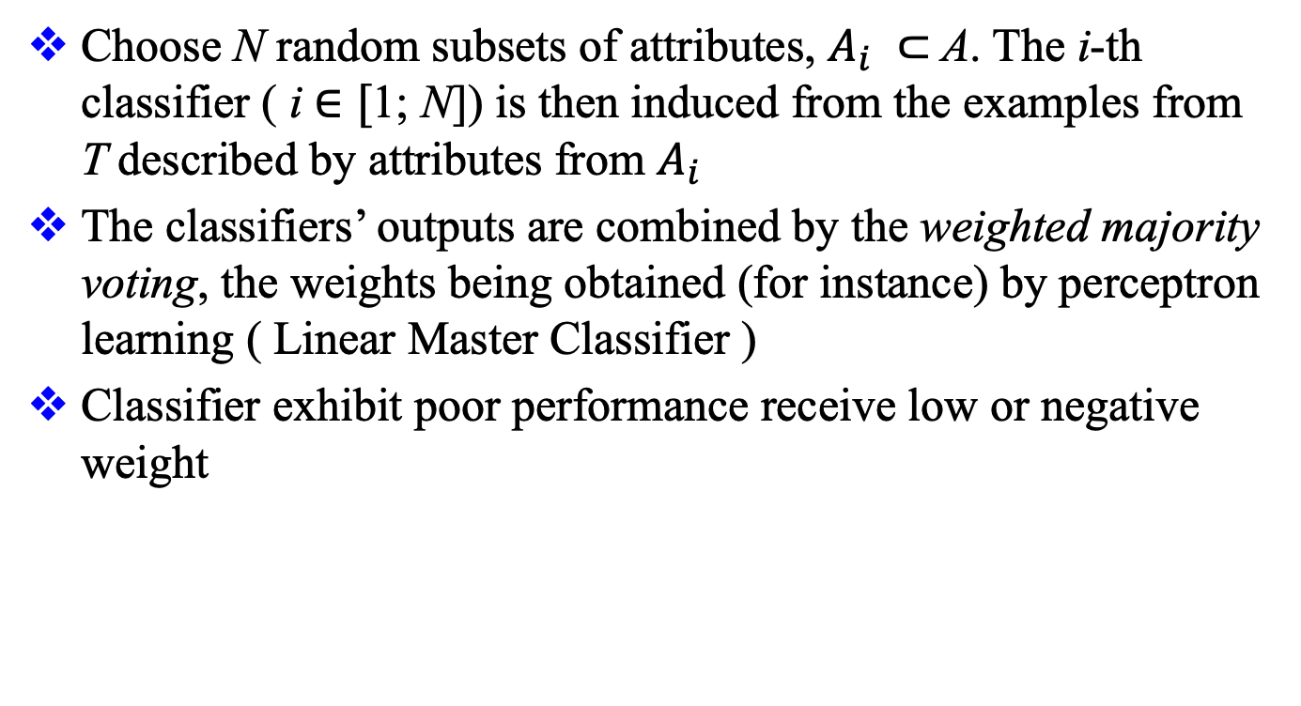
Randomizing the Attribute Set
Choose N random subsets of attributes, $A_{i} ⊂$A. The i-th classifier ( i $∈[$1; N]) is then induced from the examples from T described by attributes from $A_{i}$
The classifiers’ outputs are combined by the weighted majority voting, the weights being obtained (for instance) by perceptron learning ( Linear Master Classifier )
Classifier exhibit poor performance receive low or negative weight

Slide 20
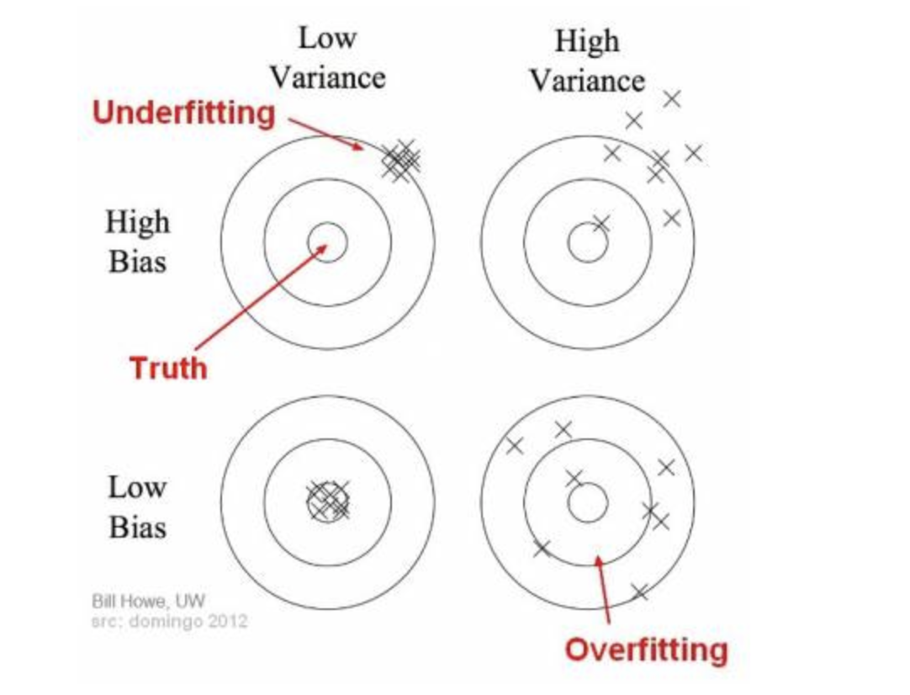
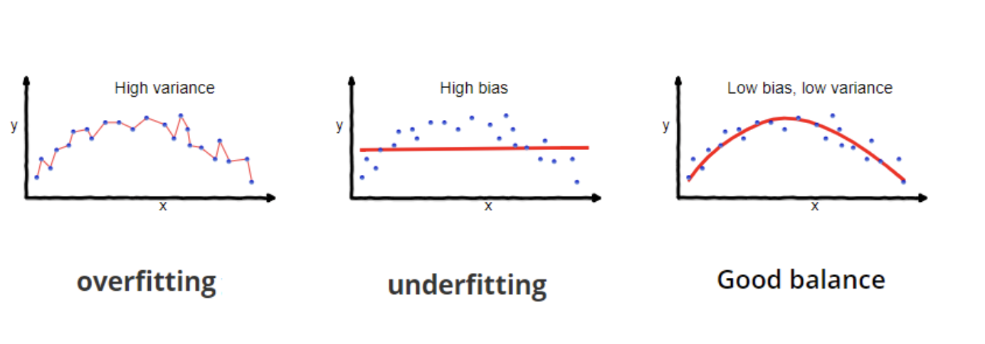
Bias & Variation errors
Non-homogeneous boosting is known to reduce both bias & variation errors
https://towardsdatascience.com/understanding-the-bias-variance-tradeoff-165e6942b229
Notes:
What is bias?
Bias is the difference between the average prediction of our model and the correct value which we are trying to predict. Model with high bias pays very little attention to the training data and oversimplifies the model. It always leads to high error on training and test data.
What is variance?
Variance is the variability of model prediction for a given data point or a value which tells us spread of our data. Model with high variance pays a lot of attention to training data and does not generalize on the data which it hasn’t seen before. As a result, such models perform very well on training data but has high error rates on test data.
Why is Bias Variance Tradeoff?
If our model is too simple and has very few parameters then it may have high bias and low variance. On the other hand if our model has large number of parameters then it’s going to have high variance and low bias. So we need to find the right/good balance without overfitting and underfitting the data.
This tradeoff in complexity is why there is a tradeoff between bias and variance. An algorithm can’t be more complex and less complex at the same time.

Slide 21
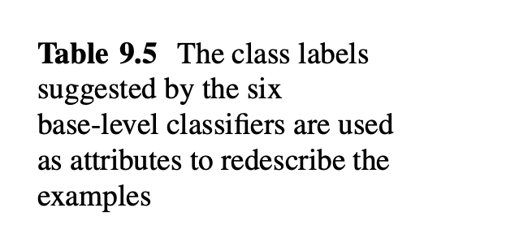
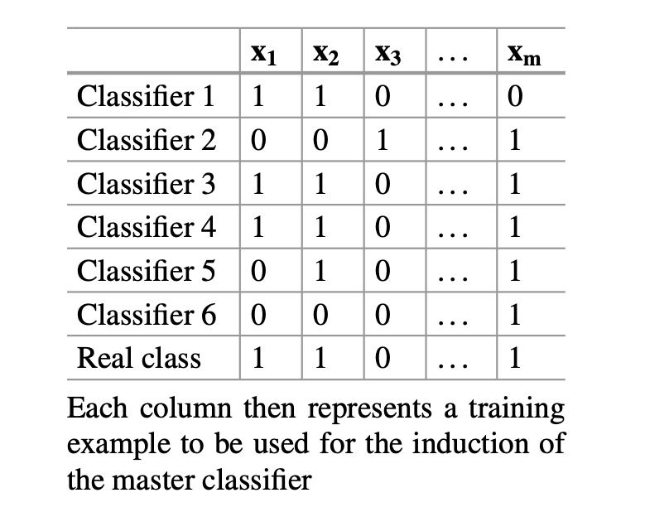
Base Classifers redescribe the examples

Slide 22
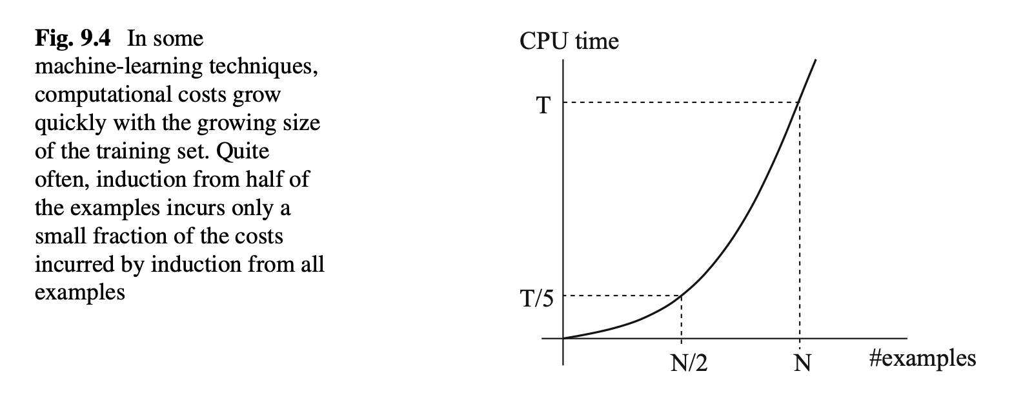
Cost Saving Benefit

Slide 23
Generalization to K Classifiers
Induction of K classifiers from a different subset, Ti, such that the size of each of them is m (a user-set constant) which is supposed to be much smaller than N in bagging approach
It will lead to significant saving in the computation cost
Similar observations can be made also in the case of Schapire’s boosting and Adaboost.

Slide 24
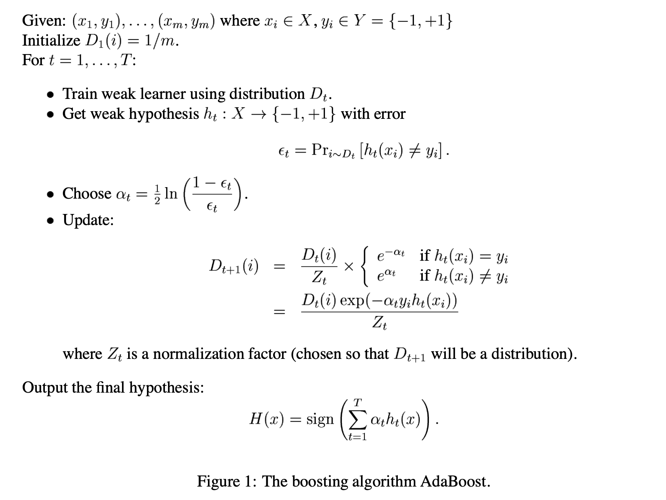
Adaptive Boosting
A Short Introduction to Boosting, Freund , Schapire 1999.9
Notes:
Adaptive Boosting, 從字面意義 Adaptive 是逐步，簡單的 sample 訓練再多次 無法提升訓練器。
藉由調整機率分佈 讓越困難的 sample 選中的機率越高。
( 到了 adaptive boosting, 跟 Bagging 當時 的假設每個 weak classifer 只要正確率比 50% 高 就可以
到了 Adaptive Boosting
對 Alpha t ( ) 直覺上的理解是 代表

Slide 25
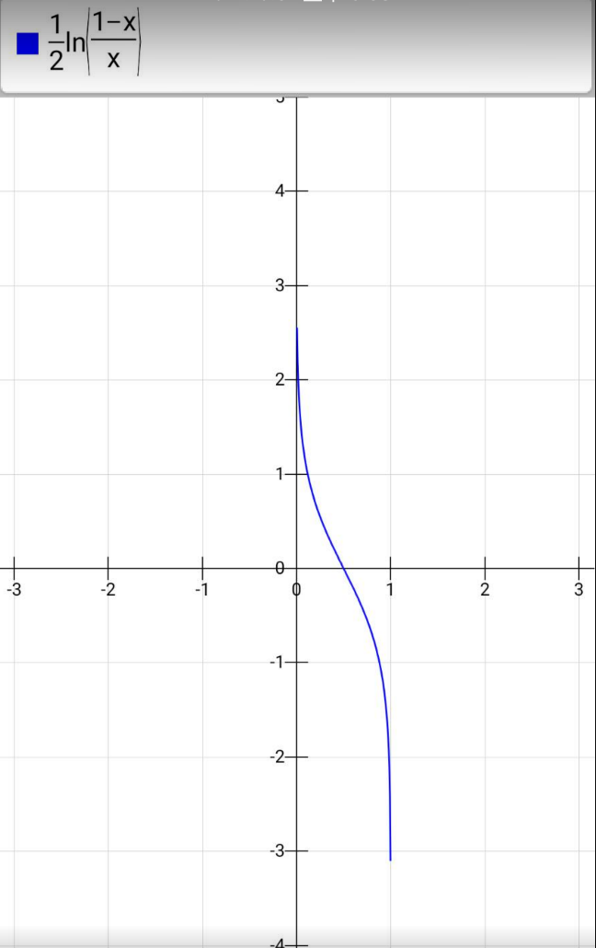
Adaptive Boosting
直覺上的理解ɑt代表 ht的權重，也就是錯誤率越低，權重越高。( ɛt<0.5, ɑt 為正值。ɛt> 0.5, ɑt 為 負值，但通常一個錯誤率大於 0.5 的訓練器會直接丟棄。）
給下一個訓練器的資料，會根據當下訓練器分類結果修正其分佈，可以讓當下訓練器正確分類的資料，其權重會調低 ，而無法正確分類的資料，其權重則會調高。
Notes:
Adaptive Boosting, 從字面意義 Adaptive 是逐步，簡單的 sample 訓練再多次 無法提升訓練器。
藉由調整機率分佈 讓越困難的 sample 選中的機率越高。
( 到了 adaptive boosting, 跟 Bagging 當時 的假設每個 weak classifer 只要正確率比 50% 高 就可以
到了 Adaptive Boosting
對 Alpha t ( ) 直覺上的理解是 代表

Slide 26
Advantages of AdaBoost
It is fast, simple and easy to program
No parameters to tune (except for the number of round T )
Not requires prior knowledge about the weak learner
Theoretical guarantees given sufficient data and a weak learner that can reliably provide only moderately accurate weak hypotheses
A Short Introduction to Boosting, Freund , Schapire 1999.9

Slide 27
Basic Adaboost Implementation
Master Classifier
linear Classifier
Perceptron
AdaBoost Classifier
Base Classifier
Decision Tree

Slide 28
Procedure
Generates X, y as 2 dimensions points with 2 class samples
Use decision tree ( sklearn.tree.DecisionTreeClassifier ) as the base ( weak ) classifier with only depth 1 and 2 leafs
Try T iterations, for each t run ( t = 0~T)
Fit a decision tree called a stump[t]
Predict the training data D(t) by this fitted tree
Mark the erroneous points with higher probability
Calculate the weight of the stump, higher error with lower weight
Use the linear perceptron as Master ( Stronger ) classifier for predicting
https://github.com/eslywadan/adaboost

Slide 29
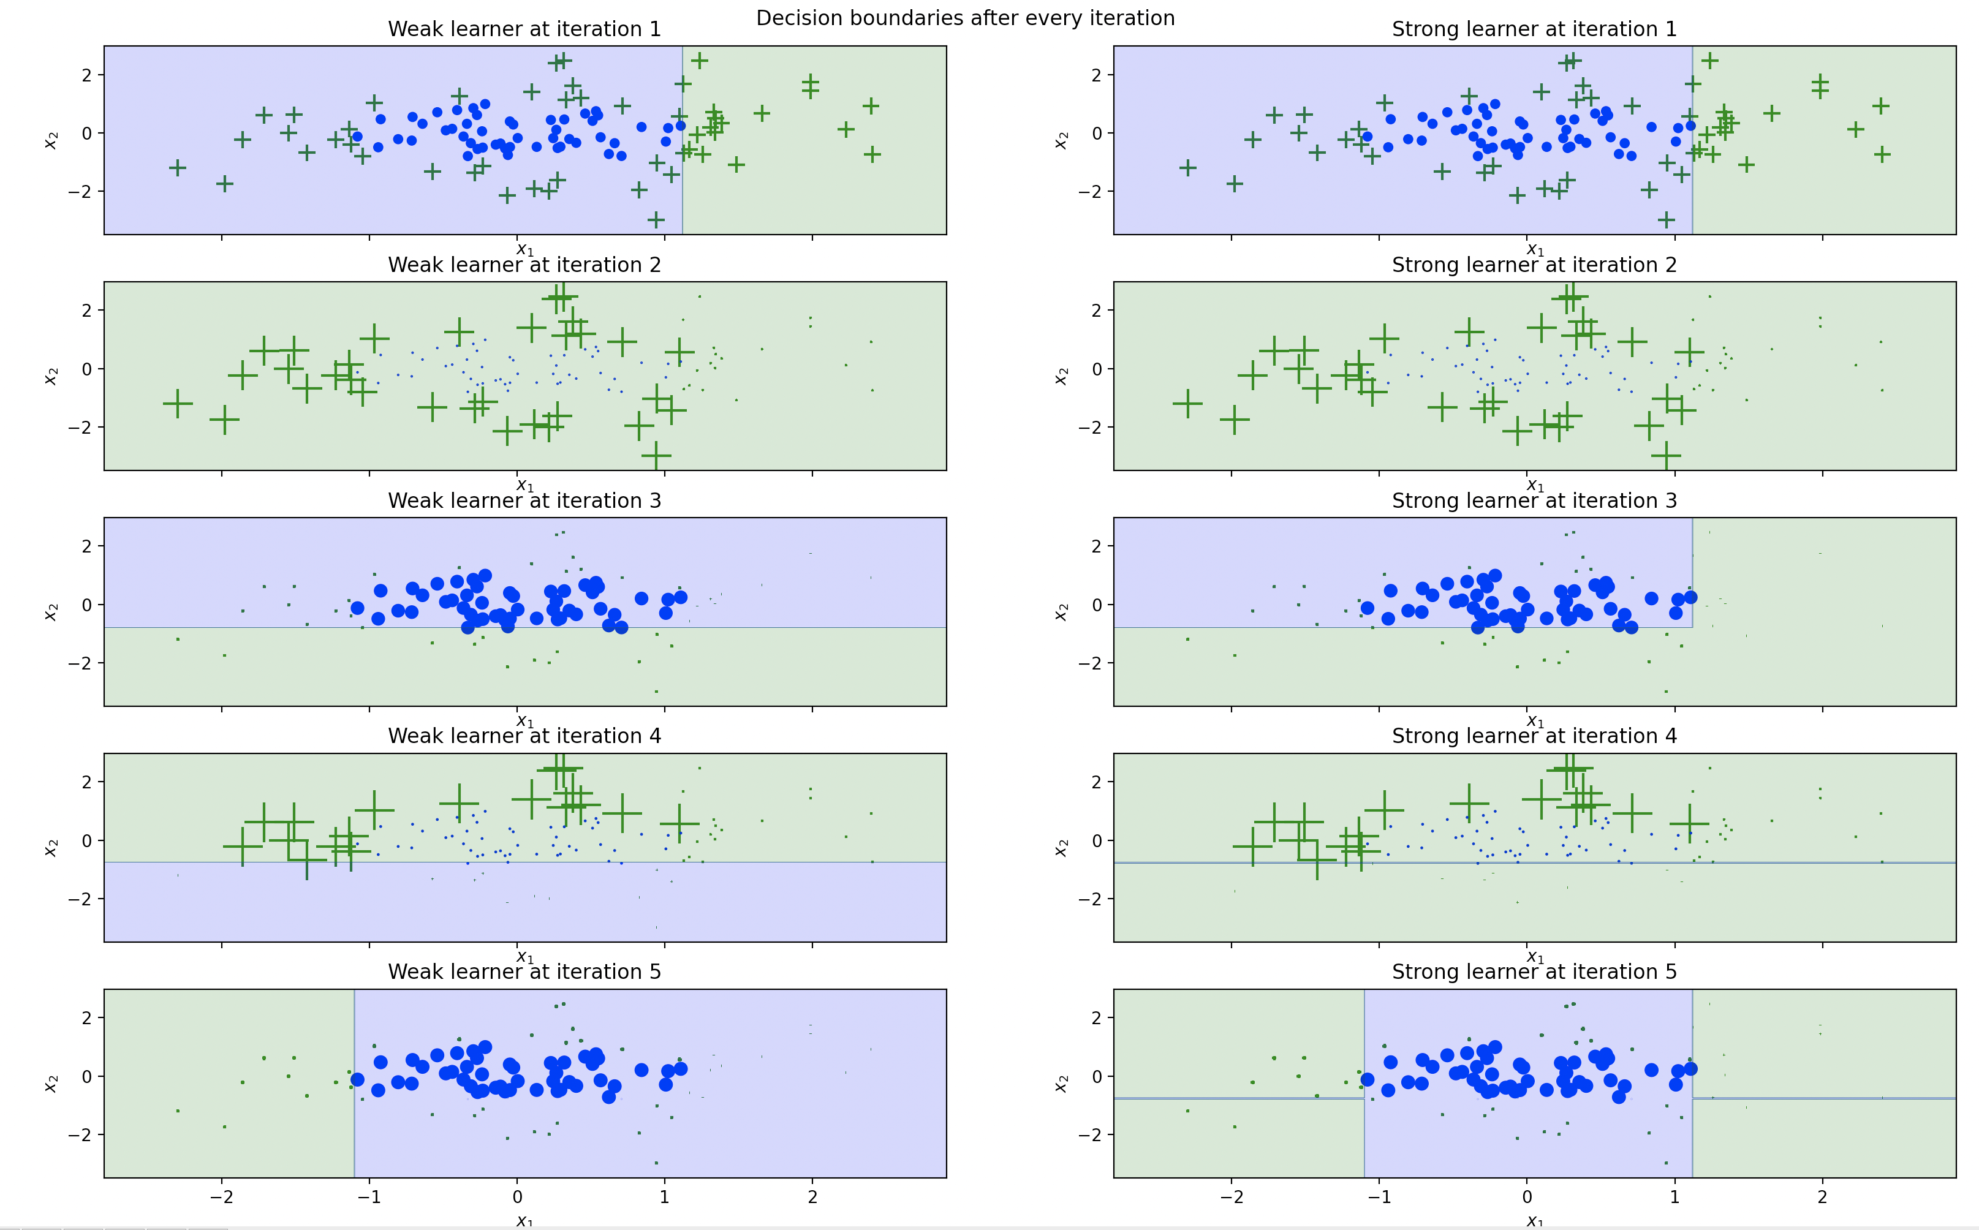
5 Iterations

Slide 30
Brief History of Gradient Boosting
Invent AdaBoost, the first successful boosting algorithm [Freund et al., 1996, Freund and Schapire, 1997]
Formulated AdaBoost as gradient descent with special loss function [Breiman et al., 1998, Breman, 1999]
Generalized AdaBoost to Gradient Boosting in order to handle a variety of loss function
http://www.ccs.neu.edu/home/vip/teach/MLcourse/4_boosting/slides/gradient_boosting.pdf

Slide 31
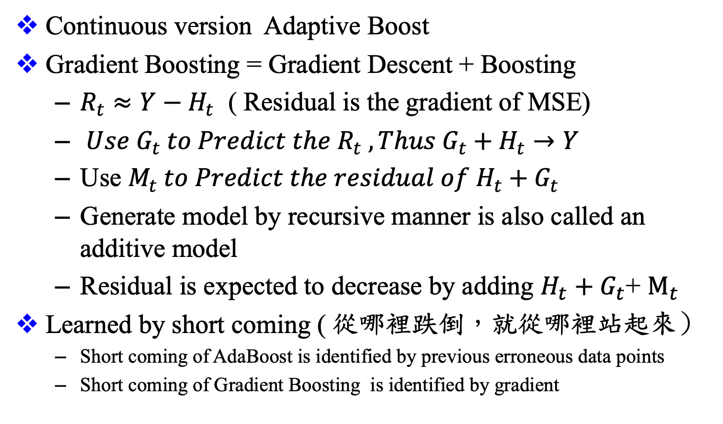
Gradient Based Boosting
Continuous version Adaptive Boost
Gradient Boosting = Gradient Descent + Boosting
$R_{t}≈Y−H_{t}$ ( Residual is the gradient of MSE)
${Use G}_{t} to Predict the{ R}_{t} , Thus G_{t}+H_{t}→Y$
Use $M_{t} to Predict the residual of H_{t}+G_{t}$
Generate model by recursive manner is also called an additive model
Residual is expected to decrease by adding $H_{t}+G_{t}$+ $M_{t}$
Learned by short coming ( 從哪裡跌倒，就從哪裡站起來）
Short coming of AdaBoost is identified by previous erroneous data points
Short coming of Gradient Boosting is identified by gradient

Slide 32
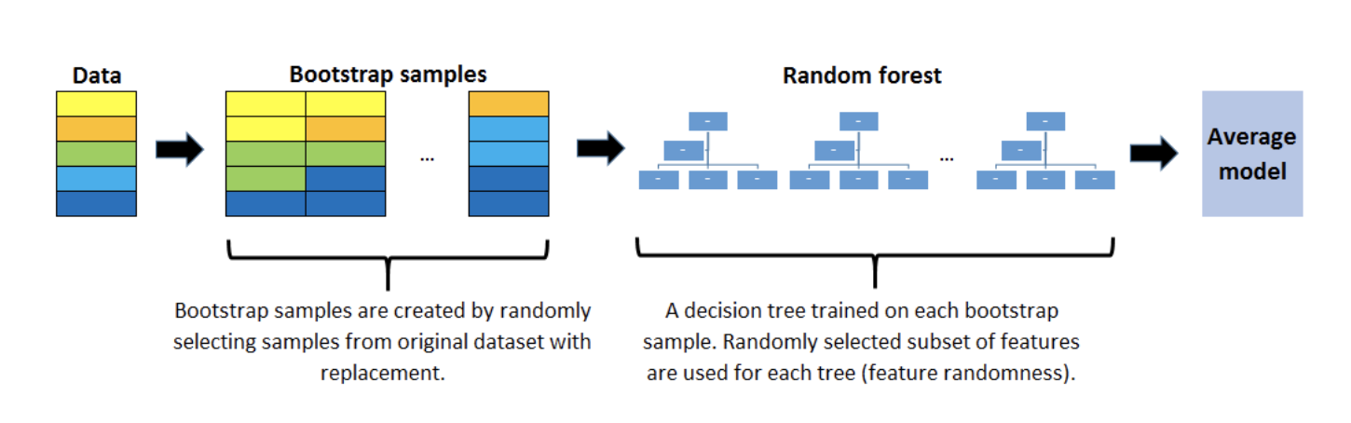
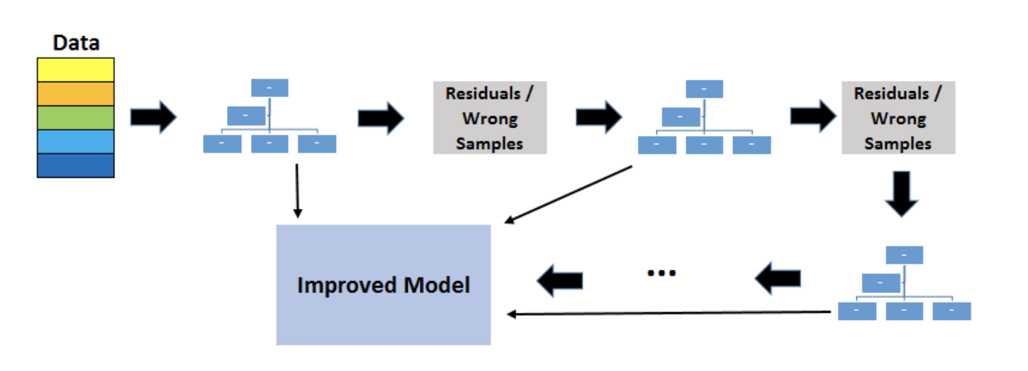
Gradient Based Boosting Decision Tree & Random Forest
Reference : 3 Key Differences Between Random Forests and GBDT | by Soner Yıldırım

Slide 33
Reference
[1] Miroslav Kubat “An Introduction to Machine Learning 2nd Edition” Chapter 9
[2] Yoav Freund, Robert E. Schapire “A Short Introduction to Boosting “
[3] A Gentle Introduction to Gradient Boosting http://www.ccs.neu.edu/home/vip/teach/MLcourse/4_boosting/slides/gradient_boosting.pdf
[4] Gradient Boosting 簡介
https://medium.com/@cwchang/gradient-boosting-%E7%B0%A1%E4%BB%8B-f3a578ae7205

Slide 34
Thanks for listening

